Slide 1
THE LANGUAGE OF TIME MANAGEMENT
HOW TO MANAGE THE DAILY INTERRUPTIONS
TO PROTECT YOUR TIME

Slide 2
HOW TO MANAGE
THE EXPECTED INTERRUPTION
“I appreciate you coming to me for help. I’m completing a proposal for GDC now, which I must send to the customer within the next hour.
I want to be as supportive and responsive as I can to your request and ensure that whatever you need, we give it the time and the attention it deserves so that we can successfully work through it together.”
“While I know it’s important to you that we handle this now, is this something that demands immediate attention and must be handled right away or can it wait until I complete this for GDC, when I can then focus all of my time and attention on you?”
Copyright © Keith Rosen 2020, Builders ® All Rights Reserved - KeithRosen.com

Slide 3
Everything is always urgent to your direct reports, peers, manager and customers.
This approach demonstrates trust, respect and an authentic desire to support them.
THE ADDITIONAL BENEFIT OF PROTECTING
YOUR TIME AND MANAGING DAILY INTURRUPTIONS
What may happen during the time they’re waiting to meet with you?
You stimulate self-reflection, critical thinking and confidence, so they can create their solutions without you.
Copyright © Keith Rosen 2020, Builders ® All Rights Reserved - KeithRosen.com

Slide 4
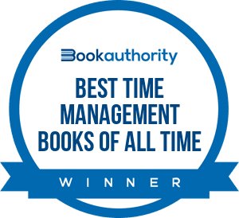
Connect With Keith!
- FEEL FREE TO SHARE THIS -
KEITHROSEN.COM
Copyright © Keith Rosen 2020, Builders ® All Rights Reserved - KeithRosen.com

