Slide 1
HOW TO
COACH
ANYONE
60
60
IN
SECONDS

Slide 2
The 60-SECOND COACHING STRATEGY
“I’m happy to share my opinion with you, Tim. However you’re much closer to this (client/situation) than I am and I trust you and your judgment on this.”
“So, what’s your opinion on how to (handle this, move forward, resolve this, deeply serve this particular client, communicate to the team in a way they would be open to your ideas)?”
They create it, they own it, act on it, and build self-accountability.
Then, you avoid repetitive conversations and get your time back.
But what if their solution is fully baked, half baked or not close to what you know is effective?
What would the next question sound like without making them wrong? →

Slide 3
60 SECOND COACHING STRATEGY
PART TWO – How to Collaboratively Coach to Create New Possibilities
“Thanks for sharing your opinion, I appreciate it.
Let’s walk through your ideas to see how they could work out. Then together, create the most effective solution that will achieve the results you want.”
Notice how this changes the conversation and outcome.
You’re being Collaborative rather than being Directive
Have a Conversation vs. an Interrogation
Now, you fill in the gaps or refine the solution as you walk through it together.
CONFIDENTIAL. For personal use only. Do not distribute. No Pictures allowed.
Copyright © Keith Rosen 2020, Owned Exclusively by Keith Rosen and Profit Builders, LLC ® All Rights Reserved – Coachquest.com

Slide 4
IF YOU HAVE TIME TO GIVE AN
ANSWER,
YOU HAVE THE TIME TO
ASK A QUESTION AND COACH
KEITHROSEN.COM

Slide 5
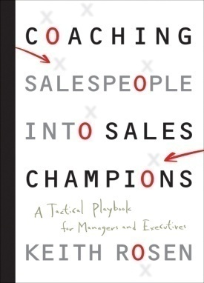
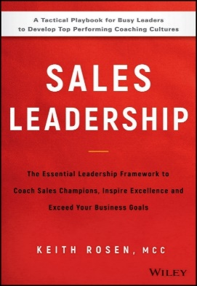
Connect With Keith!
Develop the Language and Habit of Coaching -
The Official Language of Leadership
that Develops Champions™
Copyright © Keith Rosen 2020, Builders ® All Rights Reserved - KeithRosen.com

Slide 6
Slide 11
INTELLECTUAL PROPERTY AND LEGAL NOTICE
The material, content and concepts included in this document are proprietary information and are the intellectual property of Keith Rosen, owned exclusively by Keith Rosen.
No part of this document may be reproduced or used in any form, by any means without the prior written permission of the owner. No adaptation, group use for training or repackaging without express written authorization of the author. Copyright ©, 2020 Keith Rosen and Profit Builders, LLC. All rights reserved.

