Slide 1
BECOME THE TOP CANDIDATE OF CHOICE
STAND OUT, EXEMPLIFY INNOVATION,
ESTABLISH YOUR UNIQUE VALUE
DEVELOP AN EYE-CATCHING RESUME TO FIND YOUR IDEAL JOB
Keith Rosen KeithRosen.com
Copyright © Keith Rosen 2020, Builders ® All Rights Reserved - KeithRosen.com

Slide 2
1. Get a professional headshot for your profile. Look at the profile pictures of those people you admire, or who are in a similar industry or profession. 2. Be creative! Stand out by adding your core values, hobbies, first-person bio, awards and recognition outside of work to demonstrate how uniquely well-rounded you are and the value you can offer. 3. Be FANATICAL when PROOFING for grammar and spelling! Have someone you trust review it and ask for their feedback. No second chance on this one, as your resume is a reflection of you, not only in your accomplishments but how you present it. 4. Your resume must be ONE page. I know you have a lot to share, but recruiters have seconds to scan your resume. No one is reading a resume that's two pages or longer. What you capture on one page needs to be short and compelling enough for them to want to read it. 5. When sighting your accomplishments, be as specific and measurable as you can. Measurable revenue/sales growth, hire and client retention, team performance, market growth, projects managed, awards, etc. 6. Make sure your social media profiles, especially LinkedIn, are consistent and aligned with your CV/resume. They will be checking! 7. Email – When you follow up to thank the person who interviewed you for the opportunity directly after the interview, follow these guidelines:
TOP 13 TIPS FOR WRITING A KICK-ASS RESUME
A. Keep your email short, so the recipient doesn't have to scroll. B. Thank them for the opportunity. Recap their most important goals, and how you can deliver value to achieve them. Demonstrate the fit. That is, how the position you're interviewing for and your attitude and skill-set are aligned. C. If you didn't already, ask what the next step will be. Then, mention in the email that you'll following up, as well. D. Subject lines count! Be concise, creative and grateful.

Slide 3
8. Remember, EVERY employer will be reviewing your social media profiles. NEVER post anything you'll later regret; even delete the ones that can put you in a bad light. Stay away from political, religious, racial or social opinions. Respect political correctness. Stay neutral, be kind and positive. 9. Ask for testimonials on LinkedIn, especially from your customers and co-workers. They carry a lot of weight when recruiters are combing through profiles and can quickly read 3rd party testimonials. 10. If needed, create a different version of your master resume template so that it fits for each position you're applying for. 11. Use hyperlinks when sending an electronic version of your resume. Link to anything you may want to highlight about yourself. This could include: A. Media mentions, awards, articles you've authored or published B. Live events you were involved in or presented at C. Positions you hold outside of work, (community, etc.) D. Link to your social media profiles and LinkedIn testimonials 12. For positions you've held for less than about 2 years, unless they are essential and related to the position you're applying for (skill, experience, industry relationships), leave it out. Recruiters often look down when they see a person job hop, as it questions your stability and commitment. 13. Make yourself unforgettable – just be you. What you think is expected in a new role when it comes to performance goals, as well as your past achievements are often unprecedented in many companies. Don't make any assumptions, as these are often the things that will distinguish you from the other candidates.
TOP 13 TIPS FOR WRITING A KICK-ASS RESUME

Slide 4
Additional Resources and Templates to: * Ensure You Find The Ideal Job By Creating Your Ideal Job Profile * Uncover The Right Interviewing Questions YOU Ask That Will Make You The Candidate Of Choice * Sharpen Your Leadership, Coaching and Interviewing Skills by Preparing For The Questions You’ll Be Asked During The Interview Process.
How to Interview Your Interviewer – The Interview Process Goes Both Ways
Deeper Interviewing Strategies To Avoid Mis-Hires
Interviewing Questions To Prepare For
To Ensure You’re Applying for the Position that’s Best For You, Here’s How to Create Your Ideal Career Profile
Video: How to Fearlessly Find Your Ideal Career
ONLINE SALES LEADERSHIP Coach Training Course for Management Teams to Learn How to Coach Effectively to Develop Sales Champions
FINAL TIP FROM YOUR COACH:
Keep in mind, this is a template. Edit accordingly, so that it fits for you, and is a strong reflection of who you are; your gifts, attitude, values, skills, talents and individuality.
EVERY client who used this template and leveraged all the resources I've included here ALWAYS found the job they wanted and NEVER looked back. If you'd like more personal coaching and support around preparing you and your resume to become the candidate of choice for your next dream job, email me at KR@KeithRosen.com so we can discuss how our career coaching programs will help you achieve your goals - FAST.

Slide 5
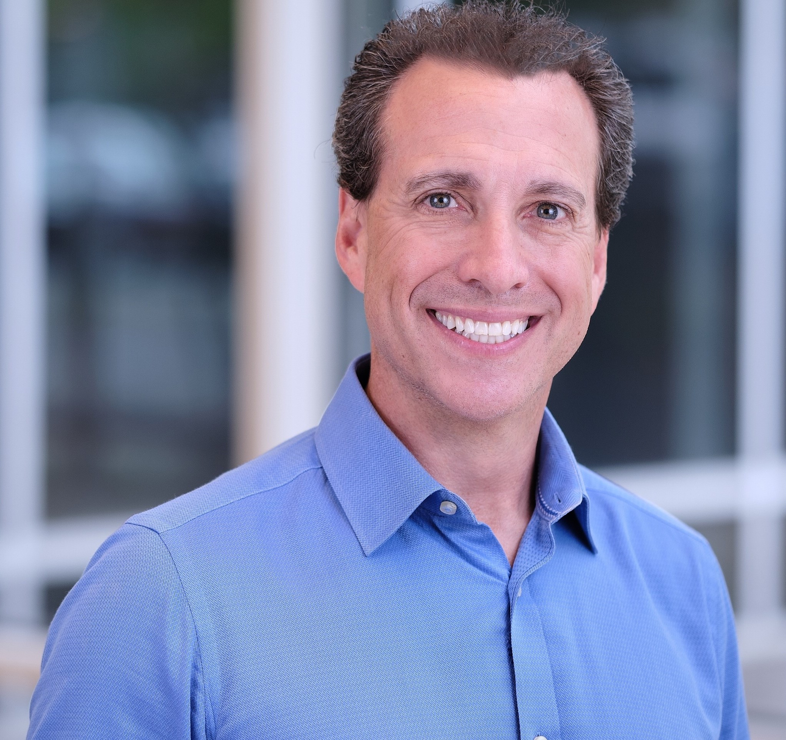
NAME
Global Executive Sales Leader (EX: who you are.)
PROFILE
WORK EXPERIENCE
Vice President, Global Sales, 01/2014 to Current
COMPANY NAME– Town, State
• Responsible for the global sales goal of 5 billion, in addition to managing and selling enterprise level customers with an average deal size of 5.6 million
• Currently, responsible for a personal yearly sales quota of 5.3 million net and have already achieved 4.5 million net, now on pace to do 8.8 million net.
• Built and strengthened productive and valuable industry partnerships to drive collaboration, engagement and revenue stream development.
• In addition to being accountable for yearly sales objectives, John also continues to own the responsibilities, sales targets and business KPI’s as Director of Sales.
• Increased company growth through effective collaboration with all departments, including, engineering, logistics, sales, operations and marketing.
Director Of Sales, 08/2006 to 12/2013
COMPANY NAME– Town, State
• Established ambitious sales targets, managed deployment strategies, sales and account managment teams and developed go-to-market plans to capitalize on all revenue opportunities that are aligned with personal and corporate values.
• Forecasted sales of $5.3 million and achieved 35% above my objective.
• Accomplished sales goals and increased global sales revenue by $8.7 million.
• Effectively resolved vendor and account problems while exceeding sales quota by 38%.
• Grew market penetration and sales figures by leveraging supplier relationships and personally overseeing negotiations resulting in 43% revenue increase.
• Encouraged the cross-selling of additional products and services.
• Led solution selling strategy initiatives to maximize Global Transportation service sales.
• Collaborated with upper management to implement continuous improvements.
• Monitored sales team performance, analyzed sales data and coached area managers.
• Owned all aspects of sales planning, development, and team and account management for global services across 5 continents.
• Achieved all KPI’s for company, regional team and individual performance through teamwork and focus on customers.
• Exceeded sales quotas and increased profitability through effective strategic selling strategies detailed, executable business planning.
• Maintained financial controls, planned business operations and controlled expenses, while pursuing new opportunities to grow business operations and boost profits.
Strategic Sales, 06/1995 to 08/2006
COMPANY NAME– Town, State
• Increased profits by 65% through generating and maintaining relationships with 75 global accounts and effectively selling new products.
• Maximized business potential by providing excellent customer service and ensuring 92% client retention.
• Drove team revenue totals by bringing in over $2.4 million in yearly sales, including being responsible for writing and presenting contracts and processing order forms.
• Exceeded established sales goals and increased client retention by 31%.
• Cold-called leads and closed on average 40 new sales each year.
During my tenure of # years at COMPANY since 1995, I’ve held several positions, including Strategic Sales Leader, Director of Sales and currently, the Vice President of Global Sales.
Coupled with more than 25 years of experience in:
• Relationship building and retention
• Performance metrics analysis
• Supply chain distribution
• Deal mechanics
• Employee development and coaching
• Customer service
• Exceeding revenue goals and sales targets
I’ve had the opportunity to leverage my skills, drive, passion and commitment to excellence, while honoring my core values. This resulted in exceeding sales goals every year, while building and coaching teams of salespeople and future sales leaders.
I bring a depth of global sales and management experience, having traveled extensively throughout Europe and Asia.
In addition to managing and selling enterprise level customers with an average deal size of 5.6 million, I’m currently responsible for managing and achieving a global yearly sales goal of 5 billion, through coaching and managing sales teams. With a yearly personal sales quota of 5.3 million net for 2019, I’m already at 4.5 million net and on pace to do 8.8 million net.
OPTION: A sentence about your values, hobbies and priorities, or other positions you hold, giving the person reading this a sense of who you are, not just what you do.
CONTACT
Mobile HERE
Email HERE
LinkedIn
PROFILE LINK HERE
References available upon request
EDUCATION AND HOBBIES
Degree (s),
University,
Continued Education, Professional Development
Certifications
Licenses
Hobbies / Other Positions
Michigan State University - East Lansing, MI
♦ Your Address Here ♦

Slide 6
Pay it forward. Feel free to share this document.
Connect With Keith!
Develop the Language and Habit of Coaching -
The Official Language of Leadership
that Develops Champions™
KEITHROSEN.COM
Copyright © Keith Rosen 2020, Builders ® All Rights Reserved - KeithRosen.com

