Slide 1
DURING COMPANY MEETINGS SOAPBOX OTHERS TALK BAD BOSS COACHES AND SABATOGUES AGENDA GOOD COACH REALISE THEIRS BAD COACH ABOUT ME COACHING ALWAYS ABOUT COAHCS GOOD BOSS CLOSES WHAT QUESITON ASK TO GUIDE PERSON WHERE WANT badboss tries tofid coaching around everything goodbossfits everything around coaching GOOD POSS PUSHED SFOR RESULT BAD BOSS FOCUSES ON THE PROCESS give you a job now

Slide 2
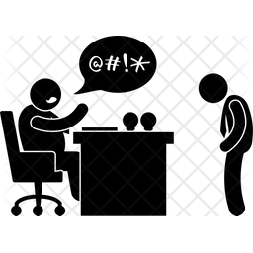
WHEN YOU ASK YOUR MANAGER FOR HELP
DEMOTIVATING
EMPOWERING
When I was in your position, this is how I did it, so you should do it this way.
I trust you and your judgment. What’s your opinion on how to achieve the results you want?
A BAD BOSS DIRECTS
AND
MANAGES
IN THEIR OWN IMAGE
A GOOD LEADER RESPECTS
EVERYONE’S POINT OF VIEW, THEN
COACHES TO LEVERAGE
EACH PERSON’S
INDIVIDUALITY AND STRENGTHS
KEITHROSEN.COM

Slide 3
WHEN YOU DON’T MEET YOUR SALES QUOTA
A BAD BOSS GETS MAD AND BLAMES YOU
A GOOD BOSS TAKES 100% ACCOUNTABILITY & COACHES YOU

Slide 4
WHEN YOU DON’T MEET YOUR SALES QUOTA
A BAD BOSS GETS MAD AND BLAMES YOU
A GOOD BOSS TAKES 100% ACCOUNTABILITY & COACHES YOU

Slide 5
WHEN YOU DON’T MEET YOUR SALES QUOTA
A BAD BOSS
GETS MAD AND
BLAMES YOU
A GOOD BOSS TAKES
100% ACCOUNTABILITY
AND COACHES YOU
KEITHROSEN.COM

Slide 6
WHEN YOU DON’T MEET YOUR SALES QUOTA
A BAD BOSS GETS MAD
AND BLAMES YOU
A GOOD BOSS TAKES
100% ACCOUNTABILITY
AND COACHES YOU

